Slide 1
FILE STORAGE FORMATS

Slide 2
Why Storage Formats are Important
Data processing and query performance
Faster read times
Faster write times
Splittable files
Schema evolution support
Advanced compression support

Slide 3
Available File Formats
Text / CSV/TSV
SequenceFile
Avro
Parquet
ORC

Slide 4
Text /CSV
Textfiles are flat files
These formats store the data in plain text
This format widely used when we dump bulk data from hadoop into an analytics database.
SequenceFiles
Sequence Files are flat files consisting of binary key/value pairs
Intermediate data(mapper output) will be stored in sequence.

Slide 5
Avro
Row storage format
Avro stores both the data definition and the data together in one message /File .
Avro is a neutral data serialization system.
Schema evolution
RPC(Remote Procedure call)
Row format
Table representation
X | Y | Z
x1 | y1 | z1
x2 | y2 | z2
x3 | y3 | z3
x4 | y4 | z4
x5 | Y5 | z5
x1 | y1 | z1 | x2 | y2 | z2 | x3 | y3 | z3 | x4 | y4 | z4 | x5 | y5 | z5

Slide 6
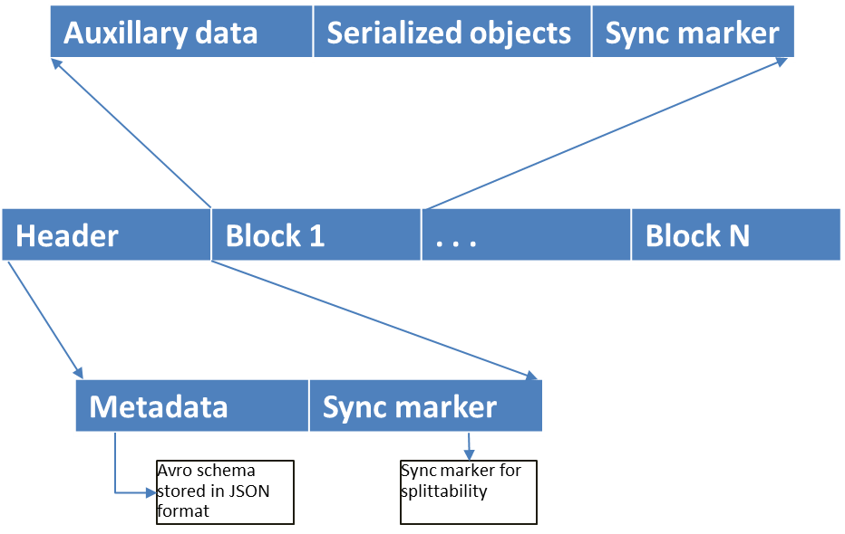
Avro File structure
Sample AVRO schema in JSON format Avro file structure
{
"type" : "record",
"name" : “TAB1",
"fields" : [ {
"name" : ”X",
"type" : "string",
}, {
"name" : “Y",
"type" : "string",
}, {
"name" : ”Z",
"type" : “string",
} ],
"doc:" : “schema for storing
TAB1"
}

Slide 7
Parquet
columnar storage format
key strength is to store nested data in truly columnar format using definition and repetition levels
Nested schema
Columnar format
X
Y
Z
x1 | x2 | x3 | x4 | x5 | y1 | y2 | y3 | y4 | y5 | z1 | z2 | z3 | z4 | z5
Table representation
encoded chunk | encoded chunk | encoded chunk
X | Y | Z
x1 | y1 | z1
x2 | y2 | z2
x3 | y3 | z3
x4 | y4 | z4
x5 | Y5 | z5

Slide 8
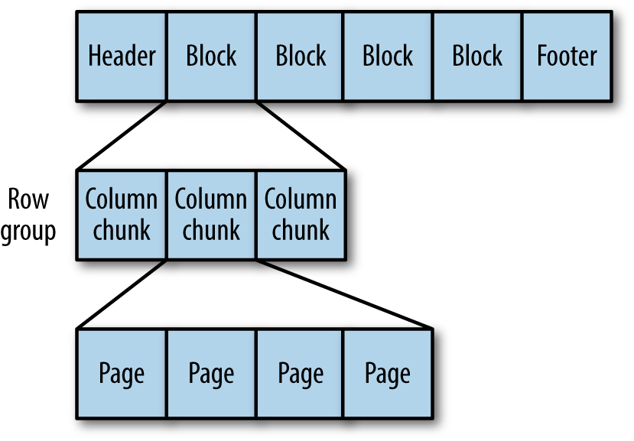
Parquet file structure
Parquet file structure

Slide 9
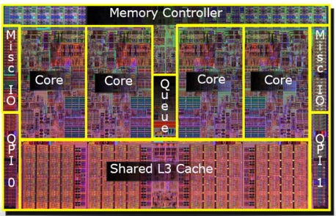

Optimizations – CPU and I/O
Statistics for filtering and query optimization
projection push down predicate push down read only the data you need
X | Y | Z
x1 | y1 | z1
x2 | y2 | z2
x3 | y3 | z3
x4 | y4 | z4
x5 | y5 | z5
X | Y | Z
x1 | y1 | z1
x2 | y2 | z2
x3 | y3 | z3
x4 | y4 | z4
x5 | y5 | z5
X | Y | Z
x1 | y1 | z1
x2 | y2 | z2
x3 | y3 | z3
x4 | y4 | z4
x5 | y5 | z5
Minimizes CPU cache misses
SLOW
cache misses costs cpu cycles

Slide 10
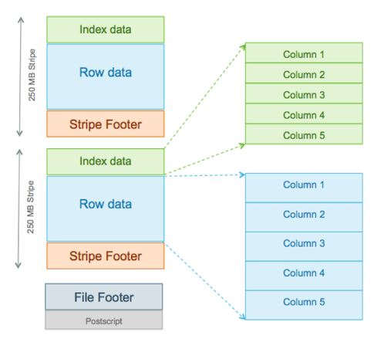
ORC
The Optimized Row Columnar (ORC) file format provides a highly efficient way to store data
ORC File format are used for improve the performance of Hive Query and reduce the access time and reduce the storage space.
ORC File structure

Slide 11
ORC File structure

Slide 12
PROS AND CONS
 | TEXT | SEQUNCE FILE | AVRO | PARQUET | ORC
DATA TYPE | Text | Binary | BInary | Binary | Binary
INTERNAL STORAGE ORDER | Row based | Row based | Row based | Column based | Clolumn based
COMPRESSION | File based | Block based | Block based | Block based | Block based
SPLITABLE | yes | yes | yes | yes | yes
SPLITABLE AFTER COMPRESSION | No | yes | yes | yes | yes

Slide 13
Statastics
I used simple query select *from tablename where condition on different file format hive tables.
Here we can see the time difference to fetch rows from table.
Textfile:
Time taken: 0.081 seconds, Fetched: 9192 row(s
Avro
Time taken: 0.132 seconds, Fetched: 9192 row(s)
ORC
Time taken: 0.061 seconds, Fetched: 9192 row(s)
Parquet
Time taken: 0.33 seconds, Fetched: 9192 row(s)
Sequence
Time taken:0.119 seconds, Fetched: 9192 row(s)
Every File Format has its own Strength and weekness.
Based on system usecase and data we need to select file format which is suitable for business usecase.

